Slide 1





Radar de Corrupción
& Derechos Económicos
Culturales y Sociales:
Derecho al Trabajo
Noviembre 20

Slide 2

Resultados Territoriales
Mapas por regiones
Radar.Trabajo según departamentos y ciudades principales

Slide 3
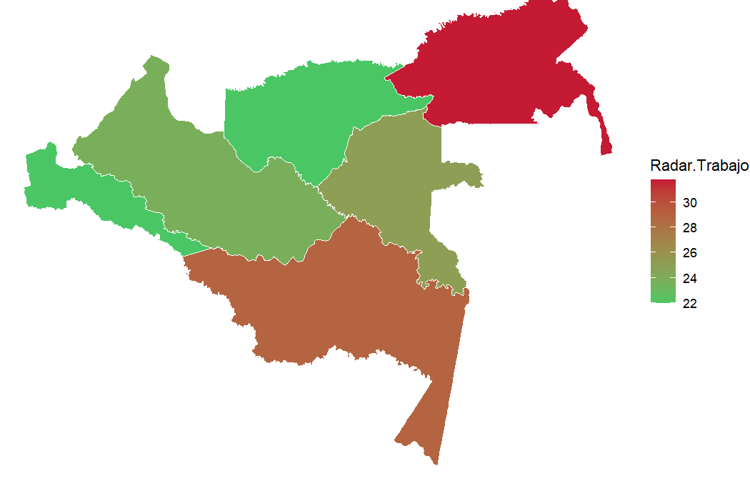
Región Amazonía - RADAR DE TRABAJO
Subcomponentes del Radar
Subcomponentes de Corrupción
Subcomponentes del derecho al trabajo
Departamento | Ciudad | Radar.Trabajo | Corrupcion | VulneraTrabajo | CorrupObservable | CorrupOculta | CapaInstituc | TDesempleo | TSubempleo | PDesocupados | PSubocupados | PFFuerzaLaboral | TGParticipacion
Putumayo | San Miguel de Mocoa | 39.7 | 47.6 | 27.8 | 13.2 | 69.4 | 65.8 | 23.8 | 10.3 | 15.2 | 13.3 | 39.4 | 60.0
Guaviare | San José del Guaviare | 36.9 | 46.4 | 22.7 | 13.2 | 69.4 | 72.1 | 9.0 | 10.5 | 6.7 | 13.0 | 16.7 | 82.7
Caquetá | Florencia | 29.3 | 33.1 | 23.8 | 12.9 | 52.9 | 72.1 | 14.7 | 11.9 | 9.4 | 14.1 | 35.9 | 64.2
Guainía | Inírida | 14.9 | 12.2 | 18.9 | 7.1 | 30.3 | 74.2 | 11.6 | 4.6 | 5.9 | 0.0 | 41.2 | 60.2
Amazonas | Leticia | 14.1 | 12.4 | 16.6 | 7.1 | 30.3 | 73.2 | 8.8 | 0.2 | 3.8 | 0.0 | 38.5 | 59.2
Vaupés | Mitú | 13.1 | 10.9 | 16.5 | 7.1 | 30.3 | 81.0 | 9.9 | 1.6 | 0.0 | 0.0 | 37.5 | 60.7

Slide 4
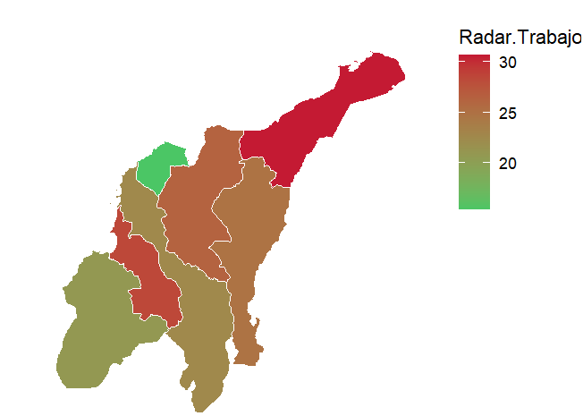


Región Caribe - RADAR DE TRABAJO
Subcomponentes del Radar
Subcomponentes de Corrupción
Subcomponentes del derecho al trabajo
Departamento | Ciudad | Radar.Trabajo | Corrupcion | VulneraTrabajo | CorrupObservable | CorrupOculta | CapaInstituc | TDesempleo | TSubempleo | PDesocupados | PSubocupados | PFFuerzaLaboral | TGParticipacion
Magdalena | Santa Marta | 36.8 | 47.3 | 21.1 | 13.2 | 69.4 | 67.4 | 11.6 | 8.1 | 7.2 | 9.3 | 39.0 | 61.0
Cesar | Valledupar | 36.7 | 45.3 | 23.7 | 13.2 | 69.4 | 77.3 | 16.1 | 10.6 | 10.1 | 12.4 | 38.4 | 61.7
Sucre | Sincelejo | 36.4 | 46.5 | 21.4 | 13.2 | 69.4 | 71.6 | 12.6 | 8.2 | 7.5 | 9.4 | 39.8 | 60.3
La Guajira | Riohacha | 36.0 | 45.1 | 22.3 | 13.2 | 69.4 | 78.3 | 15.8 | 8.1 | 9.4 | 9.3 | 39.6 | 60.7
Bolívar | Cartagena de Indias | 24.1 | 24.8 | 22.9 | 19.2 | 39.4 | 71.9 | 10.9 | 14.9 | 7.3 | 16.7 | 33.2 | 66.8
Córdoba | Montería | 23.8 | 24.8 | 22.3 | 7.9 | 48.8 | 86.8 | 14.3 | 6.1 | 9.1 | 7.2 | 37.0 | 62.9
Atlántico | Barranquilla | 21.2 | 20.0 | 23.1 | 19.2 | 39.4 | 96.2 | 11.9 | 14.6 | 7.7 | 16.6 | 35.1 | 64.8
La Guajira |  | 30.6 | 38.0 | 19.6 | 4.5 | 64.8 | 78.3 | 8.9 | 7.8 | 6.1 | 8.7 | 32.4 | 67.6
Sucre |  | 28.4 | 33.7 | 20.5 | 7.2 | 56.4 | 71.6 | 10.6 | 10.0 | 6.3 | 11.1 | 40.9 | 59.2
Magdalena |  | 26.3 | 30.0 | 20.7 | 4.7 | 52.1 | 67.4 | 9.8 | 11.9 | 6.1 | 13.2 | 38.1 | 61.9
San Andrés y Providencia |  | 25.5 | 30.1 | 18.6 | 86.1 | 11.3 | 66.8 | 6.9 | 0.2 | 6.1 | 0.0 | 33.3 | 68.4
Cesar |  | 24.8 | 26.3 | 22.6 | 4.3 | 50.0 | 77.3 | 15.9 | 9.3 | 9.3 | 11.2 | 40.9 | 59.1
Bolívar |  | 22.5 | 22.9 | 22.0 | 5.9 | 43.7 | 71.9 | 10.8 | 13.8 | 6.9 | 15.4 | 36.3 | 63.7
Córdoba |  | 20.8 | 20.2 | 21.7 | 3.2 | 45.4 | 86.8 | 12.5 | 9.5 | 7.7 | 10.8 | 38.1 | 61.8
Atlántico |  | 15.4 | 10.7 | 22.5 | 5.5 | 34.7 | 96.2 | 10.7 | 14.7 | 7.0 | 16.5 | 34.5 | 65.6

Slide 5
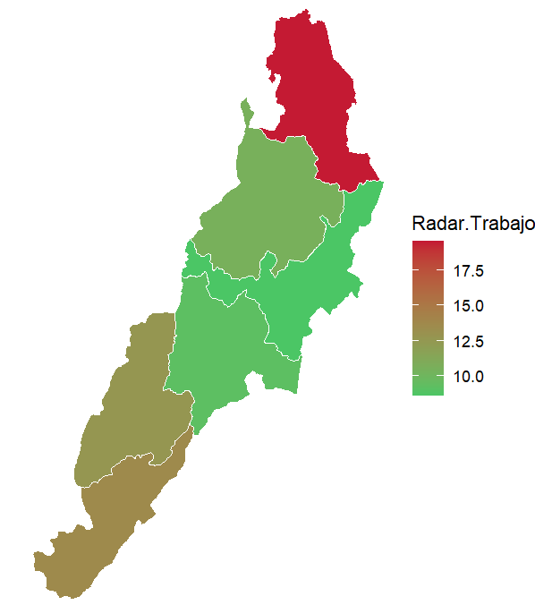
Región Central - RADAR DE TRABAJO
Subcomponentes del Radar
Subcomponentes de Corrupción
Subcomponentes del derecho al trabajo
Departamento | Ciudad | Radar.Trabajo | Corrupcion | VulneraTrabajo | CorrupObservable | CorrupOculta | CapaInstituc | TDesempleo | TSubempleo | PDesocupados | PSubocupados | PFFuerzaLaboral | TGParticipacion
Norte de Santander | San José de Cúcuta | 37.1 | 47.1 | 22.1 | 13.2 | 69.4 | 68.6 | 13.3 | 8.3 | 8.2 | 9.5 | 38.5 | 61.6
Cundinamarca | Santafé de Bogotá | 35.4 | 44.5 | 21.8 | 13.2 | 69.4 | 81.5 | 11.4 | 5.8 | 7.6 | 6.5 | 33.1 | 66.9
Boyacá | Tunja | 34.7 | 43.4 | 21.6 | 13.2 | 69.4 | 86.7 | 13.5 | 4.7 | 8.0 | 5.4 | 38.4 | 61.4
Santander | Bucaramanga | 20.6 | 21.0 | 19.9 | 19.2 | 39.4 | 90.8 | 8.9 | 4.5 | 5.8 | 5.0 | 34.5 | 65.5
Huila | Neiva | 19.7 | 19.3 | 20.4 | 12.0 | 38.0 | 79.4 | 11.6 | 5.7 | 6.8 | 6.5 | 39.9 | 60.0
Tolima | Ibagué | 16.6 | 12.9 | 22.2 | 7.1 | 30.3 | 70.9 | 16.0 | 5.1 | 8.7 | 6.3 | 45.0 | 55.0
Norte de Santander |  | 19.5 | 18.4 | 21.2 | 3.5 | 38.3 | 68.6 | 12.1 | 8.6 | 7.3 | 9.8 | 39.8 | 60.2
Huila |  | 13.6 | 10.5 | 18.2 | 3.8 | 31.1 | 79.4 | 8.4 | 4.9 | 4.9 | 5.3 | 41.5 | 58.5
Tolima |  | 12.7 | 5.9 | 22.8 | 8.7 | 20.8 | 70.9 | 15.7 | 7.5 | 9.2 | 8.9 | 41.9 | 58.0
Santander |  | 10.5 | 3.9 | 20.5 | 5.8 | 24.6 | 90.8 | 10.7 | 6.3 | 6.6 | 7.1 | 38.5 | 61.5
Cundinamarca |  | 9.8 | 0.9 | 23.1 | 7.9 | 17.5 | 81.5 | 12.7 | 10.1 | 8.6 | 11.6 | 32.3 | 67.7
Cundinamarca |  | 9.2 | 0.9 | 21.8 | 7.9 | 17.5 | 81.5 | 11.4 | 5.8 | 7.6 | 6.5 | 33.1 | 66.9
Boyacá |  | 8.6 | 0.6 | 20.7 | 6.1 | 19.3 | 86.7 | 10.7 | 8.5 | 6.5 | 9.5 | 39.4 | 60.7

Slide 6
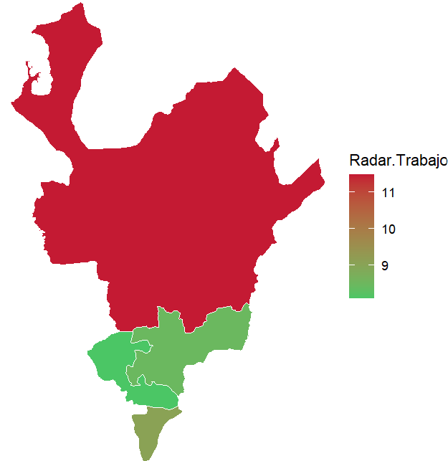
Región EjeCafetero - RADAR DE TRABAJO
Subcomponentes del Radar
Subcomponentes de Corrupción
Subcomponentes del derecho al trabajo
Departamento | Ciudad | Radar.Trabajo | Corrupcion | VulneraTrabajo | CorrupObservable | CorrupOculta | CapaInstituc | TDesempleo | TSubempleo | PDesocupados | PSubocupados | PFFuerzaLaboral | TGParticipacion
Risaralda | Pereira | 18.6 | 17.2 | 20.7 | 12.0 | 38.0 | 90.3 | 11.2 | 5.3 | 6.7 | 5.9 | 39.7 | 60.3
Antioquia | Medellín | 14.4 | 9.6 | 21.6 | 7.1 | 30.3 | 87.4 | 10.8 | 6.4 | 7.1 | 7.2 | 34.3 | 65.7
Caldas | Manizales | 13.5 | 9.2 | 20.1 | 7.1 | 30.3 | 89.6 | 10.1 | 4.0 | 6.1 | 4.5 | 40.0 | 60.0
Antioquia | Armenia | 10.5 | 3.7 | 20.6 | 4.4 | 24.2 | 87.4 | 12.1 | 5.0 | 6.7 | 5.6 | 43.9 | 56.2
Antioquia |  | 11.5 | 5.5 | 20.4 | 4.5 | 26.5 | 87.4 | 10.1 | 5.8 | 6.3 | 6.5 | 37.0 | 63.0
Quindío |  | 9.1 | 0.7 | 21.6 | 3.2 | 15.3 | 96.0 | 13.3 | 6.3 | 7.7 | 7.3 | 42.2 | 57.7
Caldas |  | 8.5 | 0.7 | 20.1 | 4.7 | 21.0 | 89.6 | 10.9 | 4.8 | 6.3 | 5.3 | 41.9 | 58.1
Risaralda |  | 8.1 | 0.1 | 20.1 | 2.9 | 18.5 | 90.3 | 10.6 | 5.5 | 6.2 | 6.3 | 41.5 | 58.5

Slide 7
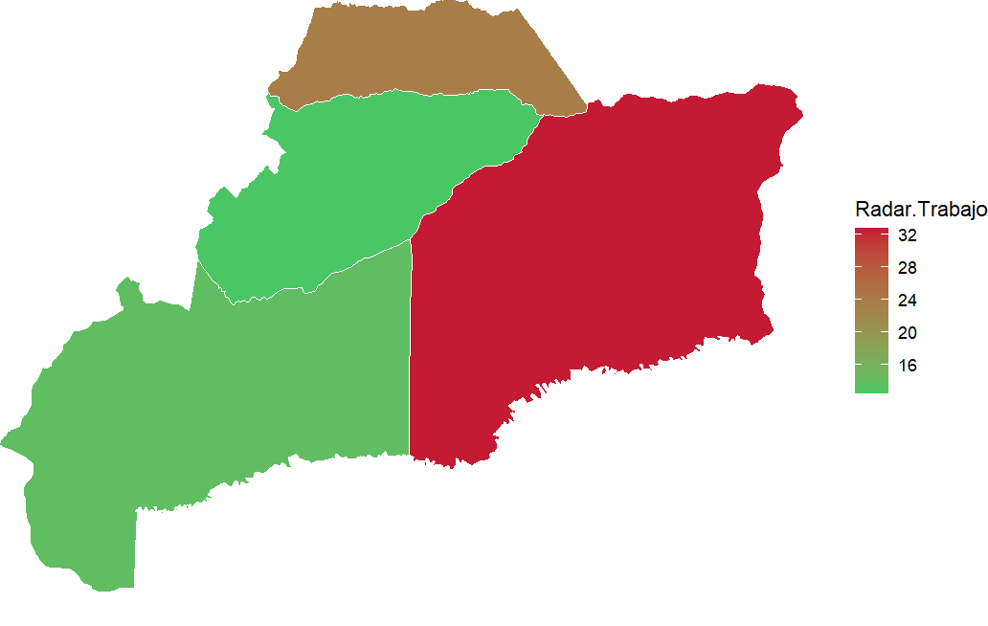
Llanos Orientales - RADAR DE TRABAJO
Subcomponentes del Radar
Subcomponentes de Corrupción
Subcomponentes del derecho al trabajo
Departamento | Ciudad | Radar.Trabajo | Corrupcion | VulneraTrabajo | CorrupObservable | CorrupOculta | CapaInstituc | TDesempleo | TSubempleo | PDesocupados | PSubocupados | PFFuerzaLaboral | TGParticipacion
Casanare | Yopal | 38.3 | 48.1 | 23.6 | 14.6 | 75.5 | 91.1 | 11.9 | 11.2 | 8.5 | 12.8 | 24.8 | 75.3
Vichada | Puerto Carreño | 25.7 | 24.4 | 27.7 | 12.0 | 38.0 | 54.0 | 18.9 | 8.8 | 16.7 | 14.3 | 25.0 | 74.8
Meta | Villavicencio | 19.0 | 17.7 | 21.1 | 13.3 | 36.9 | 85.7 | 10.6 | 6.5 | 7.0 | 7.2 | 33.9 | 66.2
Vichada |  | 32.8 | 36.2 | 27.7 | 2.8 | 57.3 | 54.0 | 18.9 | 8.8 | 16.7 | 14.3 | 25.0 | 74.8
Arauca |  | 23.5 | 18.8 | 30.7 | 3.2 | 39.0 | 68.5 | 29.4 | 9.5 | 18.8 | 13.8 | 35.9 | 64.2
Meta |  | 13.8 | 9.3 | 20.7 | 5.4 | 30.3 | 85.7 | 11.2 | 6.2 | 7.1 | 7.0 | 36.3 | 63.6
Casanare |  | 12.4 | 5.0 | 23.6 | 2.6 | 27.7 | 91.1 | 11.9 | 11.2 | 8.5 | 12.8 | 24.8 | 75.3

Slide 8
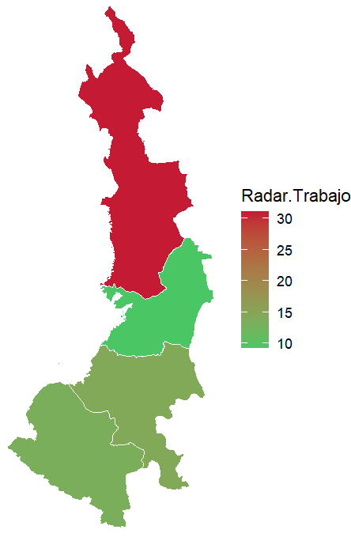
Región Pacífico - RADAR DE TRABAJO
Subcomponentes del Radar
Subcomponentes de Corrupción
Subcomponentes del derecho al trabajo
Departamento | Ciudad | Radar.Trabajo | Corrupcion | VulneraTrabajo | CorrupObservable | CorrupOculta | CapaInstituc | TDesempleo | TSubempleo | PDesocupados | PSubocupados | PFFuerzaLaboral | TGParticipacion
Nariño | San Juan de Pasto | 36.1 | 44.2 | 24.0 | 13.2 | 69.4 | 82.8 | 12.0 | 14.2 | 7.9 | 16.1 | 33.2 | 66.9
Valle del Cauca | Santiago de Cali | 34.0 | 41.7 | 22.5 | 13.2 | 69.4 | 95.7 | 11.5 | 9.9 | 7.7 | 11.2 | 33.1 | 66.9
Chocó | Quibdó | 22.2 | 21.0 | 23.9 | 12.0 | 38.0 | 71.1 | 23.8 | 3.0 | 12.5 | 3.0 | 46.3 | 53.7
Cauca | Popayán | 19.9 | 18.1 | 22.5 | 12.0 | 38.0 | 85.5 | 12.6 | 10.5 | 7.7 | 12.0 | 39.4 | 60.6
Chocó |  | 31.1 | 40.4 | 17.0 | 3.4 | 66.6 | 71.1 | 12.5 | 2.0 | 5.6 | 2.1 | 56.5 | 43.5
Cauca |  | 14.3 | 9.7 | 21.1 | 2.0 | 32.5 | 85.5 | 8.7 | 12.6 | 5.6 | 13.8 | 35.0 | 65.1
Nariño |  | 13.5 | 9.0 | 20.3 | 2.0 | 30.9 | 82.8 | 6.2 | 8.8 | 4.6 | 9.4 | 25.2 | 74.8
Valle del Cauca |  | 9.3 | 0.3 | 22.7 | 4.9 | 19.9 | 95.7 | 13.2 | 9.2 | 8.5 | 10.7 | 35.7 | 64.3

Slide 9
Gracias!

