Slide 1





Radar de Corrupción
& Derechos Económicos
Culturales y Sociales:
Servicios Públicos Domiciliarios
Resultados Territoriales 2023

Slide 2
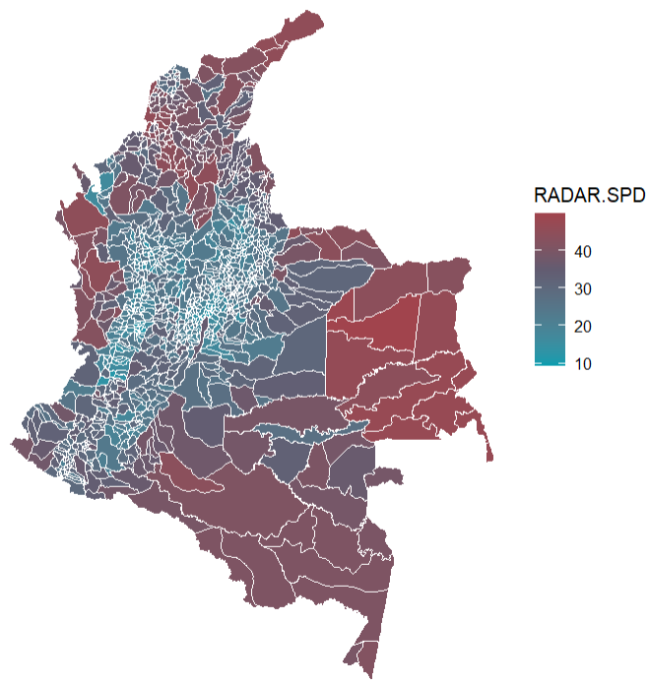
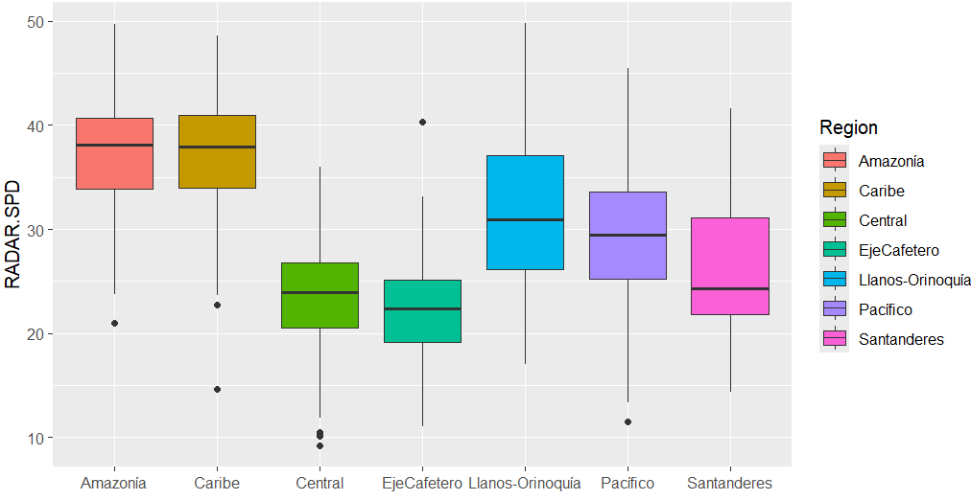
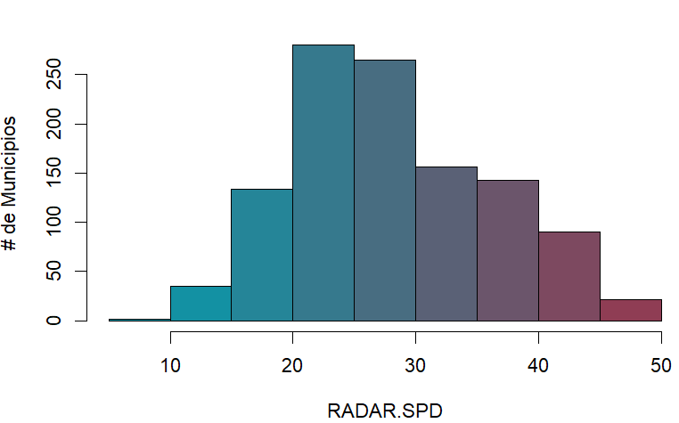
Radar de Servicios Públicos Domiciliarios
A mayor valor en el RADAR.SPD mayor posibilidad de corrupción y mayor vulneración en los derechos al acceso de calidad a los Servicios Públicos Domiciliarios en Colombia
Se obtiene un indicador que varía entre 9,2 y 49,8.

Slide 3
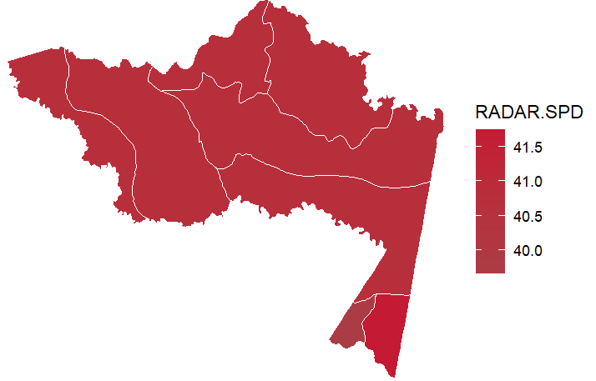
Amazonas – Radar de Servicios Públicos Domiciliarios
Radar de Servicios Públicos Domiciliarios por municipios
Subcomponentes del Radar
Subcomponentes de Corrupción
Subcomponentes de Servicios Públicos
Municipio | RADAR.SPD | 1 Corrupción | 2 Vulneración SPD | 1.1 Corrupción Observable | 1.2 Corrupción Oculta | 1.3 Capacidad Institucional | 2.1 Agua | 2.2 Energia | 2.3 Aseo
Leticia | 41.74 | 46.23 | 35.02 | 7.29 | 67.31 | 67.84 | 58.81 | 10.97 | 35.52
Puerto Nariño | 39.66 | 43.89 | 33.31 | 1.83 | 66.78 | 67.84 | 32.13 | 37.57 | 27.17

Slide 4
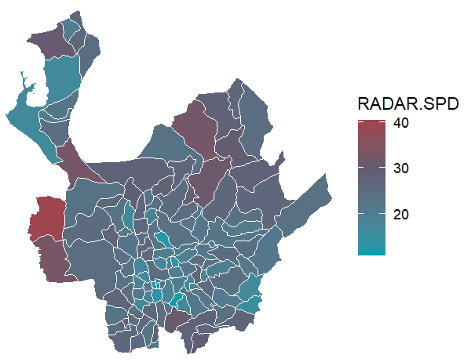
Antioquia – Radar de Servicios Públicos Domiciliarios
Top de municipios con el mayor valor en el Radar de Servicios Públicos
Subcomponentes del Radar
Subcomponentes de Corrupción
Subcomponentes de Servicios Públicos
Municipio | RADAR.SPD | 1 Corrupción | 2 Vulneración SPD | 1.1 Corrupción Observable | 1.2 Corrupción Oculta | 1.3 Capacidad Institucional | 2.1 Agua | 2.2 Energia | 2.3 Aseo
Murindó | 40.34 | 30.77 | 54.70 | 6.21 | 46.30 | 56.32 | 48.86 | 61.26 | 53.27
Vigía del Fuerte | 33.16 | 26.06 | 43.80 | 8.40 | 39.46 | 56.32 | 63.10 | 15.77 | 61.27
Mutatá | 32.80 | 26.74 | 41.88 | 10.36 | 39.46 | 56.32 | 74.86 | 2.53 | 54.62
Cáceres | 32.41 | 29.48 | 36.79 | 6.14 | 44.72 | 56.32 | 59.45 | 10.19 | 44.70
Anorí | 31.54 | 24.23 | 42.51 | 4.36 | 38.93 | 56.32 | 59.20 | 17.88 | 58.43
Abejorral | 30.76 | 16.02 | 52.85 | 4.99 | 28.41 | 56.32 | 76.12 | 13.77 | 84.49
Necoclí | 30.37 | 24.16 | 39.68 | 2.98 | 39.46 | 56.32 | 63.13 | 2.53 | 67.10
Zaragoza | 29.85 | 25.05 | 37.06 | 4.31 | 39.98 | 56.32 | 65.20 | 2.53 | 49.86
Nariño | 29.72 | 21.81 | 41.59 | 4.69 | 35.77 | 56.32 | 62.28 | 7.87 | 67.66
Peque | 29.03 | 29.29 | 28.63 | 6.81 | 44.20 | 56.32 | 44.44 | 2.53 | 49.22
Hispania | 28.93 | 24.71 | 35.26 | 11.77 | 36.30 | 56.32 | 46.98 | 15.05 | 52.25

Slide 5
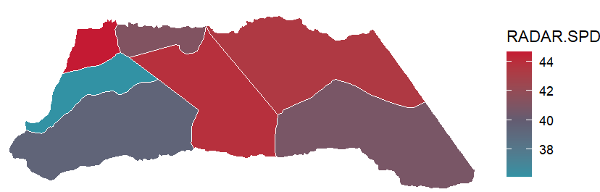
Arauca – Radar de Servicios Públicos Domiciliarios
Radar de Servicios Públicos Domiciliarios por municipios
Subcomponentes del Radar
Subcomponentes de Corrupción
Subcomponentes de Servicios Públicos
Municipio | RADAR.SPD | 1 Corrupción | 2 Vulneración SPD | 1.1 Corrupción Observable | 1.2 Corrupción Oculta | 1.3 Capacidad Institucional | 2.1 Agua | 2.2 Energia | 2.3 Aseo
Saravena | 44.66 | 45.66 | 43.16 | 2.52 | 63.01 | 37.53 | 33.50 | 46.92 | 54.95
Puerto Rondón | 43.90 | 39.67 | 50.24 | 4.67 | 54.59 | 37.53 | 54.62 | 40.92 | 60.13
Arauca | 43.41 | 49.41 | 34.42 | 16.85 | 61.43 | 37.53 | 45.84 | 15.62 | 49.18
Arauquita | 41.16 | 46.82 | 32.68 | 2.22 | 64.59 | 37.53 | 37.60 | 24.59 | 39.00
Cravo Norte | 40.80 | 37.87 | 45.19 | 0.70 | 54.06 | 37.53 | 39.80 | 57.28 | 31.82
Tame | 39.42 | 46.03 | 29.51 | 3.58 | 63.01 | 37.53 | 41.30 | 14.52 | 35.90
Fortul | 36.12 | 44.06 | 24.21 | 0.36 | 61.96 | 37.53 | 32.78 | 14.52 | 26.45

Slide 6
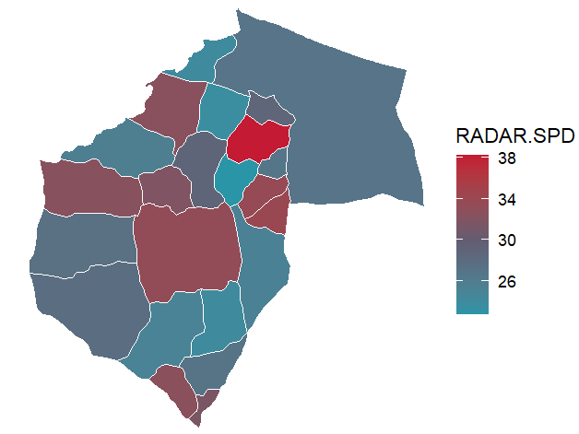
Atlántico – Radar de Servicios Públicos Domiciliarios
Top de municipios con el mayor valor en el Radar de Servicios
Subcomponentes del Radar
Subcomponentes de Corrupción
Subcomponentes de Servicios Públicos
Municipio | RADAR.SPD | 1 Corrupción | 2 Vulneración SPD | 1.1 Corrupción Observable | 1.2 Corrupción Oculta | 1.3 Capacidad Institucional | 2.1 Agua | 2.2 Energia | 2.3 Aseo
Malambo | 38.24 | 32.18 | 47.34 | 4.09 | 44.77 | 33.78 | 59.92 | 25.12 | 66.61
Palmar de Varela | 34.04 | 28.92 | 41.73 | 3.20 | 41.08 | 33.78 | 30.39 | 43.28 | 61.30
Santo Tomás | 33.70 | 29.30 | 40.29 | 4.29 | 41.08 | 33.78 | 48.06 | 26.01 | 53.28
Sabanalarga | 33.36 | 30.54 | 37.61 | 3.01 | 43.19 | 33.78 | 49.95 | 13.29 | 61.55
Santa Lucía | 32.69 | 28.22 | 39.41 | 1.19 | 41.08 | 33.78 | 27.27 | 42.47 | 57.57
Tubará | 32.60 | 29.38 | 37.44 | 4.51 | 41.08 | 33.78 | 27.27 | 37.55 | 57.57
Piojó | 32.49 | 28.69 | 38.19 | 2.54 | 41.08 | 33.78 | 27.27 | 39.42 | 57.57
Usiacurí | 31.98 | 28.55 | 37.12 | 2.15 | 41.08 | 33.78 | 31.21 | 51.90 | 19.37
Suan | 31.53 | 29.20 | 35.01 | 4.00 | 41.08 | 33.78 | 28.77 | 25.69 | 66.15
Baranoa | 28.88 | 29.06 | 28.60 | 3.61 | 41.08 | 33.78 | 32.57 | 22.98 | 31.89

Slide 7
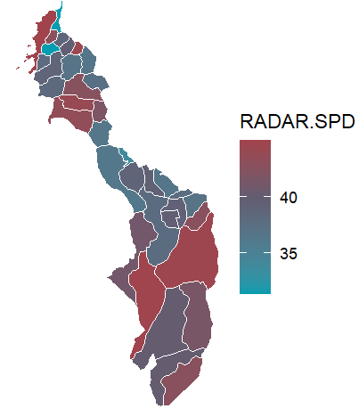
Bolívar – Radar de Servicios Públicos Domiciliarios
Top de municipios con el mayor valor en el Radar de Servicios Públicos Domiciliarios
Subcomponentes del Radar
Subcomponentes de Corrupción
Subcomponentes de Servicios Públicos
Municipio | RADAR.SPD | 1 Corrupción | 2 Vulneración SPD | 1.1 Corrupción Observable | 1.2 Corrupción Oculta | 1.3 Capacidad Institucional | 2.1 Agua | 2.2 Energia | 2.3 Aseo
Norosí | 48.62 | 37.59 | 65.16 | 0.91 | 53.75 | 38.21 | 51.45 | 87.40 | 48.12
Tiquisio | 45.07 | 38.06 | 55.58 | 7.07 | 51.65 | 38.21 | 33.27 | 80.98 | 49.39
Cartagena | 44.95 | 43.46 | 47.20 | 21.28 | 52.17 | 38.21 | 54.07 | 40.29 | 47.28
Montecristo | 44.87 | 42.29 | 48.73 | 1.11 | 59.54 | 38.21 | 32.36 | 69.56 | 39.82
Morales | 44.63 | 45.75 | 42.95 | 6.19 | 61.65 | 38.21 | 40.42 | 45.80 | 42.29
Soplaviento | 44.43 | 36.07 | 56.98 | 4.99 | 50.07 | 38.21 | 42.31 | 73.75 | 52.79
San Jacinto | 43.96 | 36.77 | 54.73 | 4.60 | 51.12 | 38.21 | 47.02 | 69.23 | 41.14
El Carmen de Bolívar | 43.44 | 39.69 | 49.06 | 5.71 | 54.28 | 38.21 | 38.84 | 57.55 | 52.53
Santa Rosa | 42.80 | 36.60 | 52.09 | 2.91 | 51.65 | 38.21 | 39.63 | 68.52 | 44.16
Río Viejo | 42.73 | 38.49 | 49.09 | 5.90 | 52.70 | 38.21 | 44.54 | 56.79 | 42.77

Slide 8
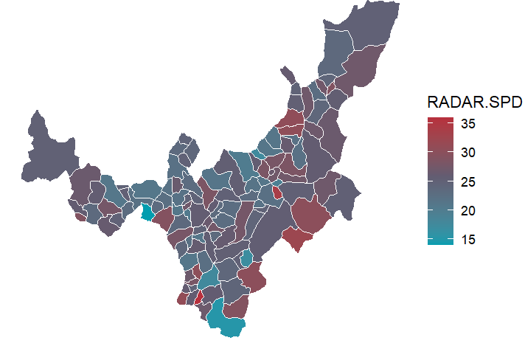
Boyacá – Radar de Servicios Públicos Domiciliarios
Top de municipios con el mayor valor en el Radar de Servicios Públicos
Subcomponentes del Radar
Subcomponentes de Corrupción
Subcomponentes de Servicios Públicos
Municipio | RADAR.SPD | 1 Corrupción | 2 Vulneración SPD | 1.1 Corrupción Observable | 1.2 Corrupción Oculta | 1.3 Capacidad Institucional | 2.1 Agua | 2.2 Energia | 2.3 Aseo
Almeida | 35.97 | 36.78 | 34.74 | 48.02 | 33.50 | 45.47 | 45.99 | 14.77 | 52.17
Monguí | 33.83 | 27.82 | 42.86 | 22.41 | 33.50 | 45.47 | 43.77 | 29.76 | 67.22
Pajarito | 32.22 | 27.37 | 39.51 | 21.11 | 33.50 | 45.47 | 49.45 | 20.52 | 57.59
Guayatá | 30.95 | 22.36 | 43.83 | 6.80 | 33.50 | 45.47 | 56.57 | 19.97 | 66.05
Susacón | 30.64 | 35.00 | 24.09 | 42.92 | 33.50 | 45.47 | 16.50 | 23.39 | 40.69
Sativanorte | 30.58 | 23.57 | 41.09 | 10.27 | 33.50 | 45.47 | 48.01 | 26.49 | 56.43
Pachavita | 30.31 | 28.34 | 33.26 | 23.88 | 33.50 | 45.47 | 39.62 | 11.41 | 64.25
Páez | 30.22 | 21.30 | 43.61 | 3.76 | 33.50 | 45.47 | 58.49 | 18.84 | 63.37
Labranzagrande | 30.18 | 28.24 | 33.08 | 23.62 | 33.50 | 45.47 | 25.61 | 32.04 | 50.10
Ráquira | 29.27 | 21.35 | 41.16 | 3.92 | 33.50 | 45.47 | 49.22 | 23.80 | 59.74

Slide 9
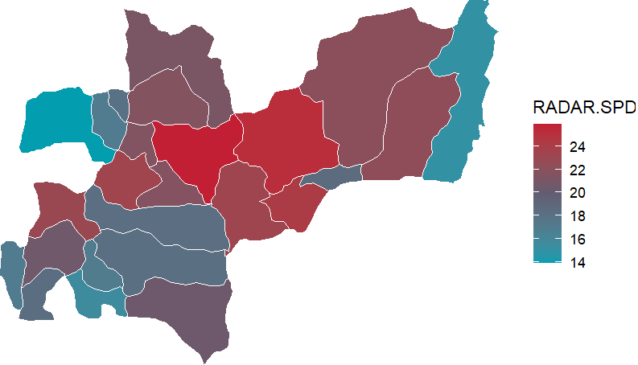
Caldas – Radar de Servicios Públicos Domiciliarios
Top de municipios con el mayor valor en el Radar de Servicios Públicos
Subcomponentes del Radar
Subcomponentes de Corrupción
Subcomponentes de Servicios Públicos
Municipio | RADAR.SPD | 1 Corrupción | 2 Vulneración SPD | 1.1 Corrupción Observable | 1.2 Corrupción Oculta | 1.3 Capacidad Institucional | 2.1 Agua | 2.2 Energia | 2.3 Aseo
Salamina | 25.88 | 16.62 | 39.76 | 3.66 | 29.49 | 55.00 | 43.93 | 26.71 | 57.52
Pensilvania | 25.25 | 16.79 | 37.95 | 4.13 | 29.49 | 55.00 | 45.97 | 23.37 | 51.06
San José | 24.52 | 15.88 | 37.49 | 1.53 | 29.49 | 55.00 | 53.75 | 9.34 | 61.25
Manzanares | 24.20 | 15.93 | 36.60 | 2.89 | 28.97 | 55.00 | 51.18 | 19.43 | 41.76
Filadelfia | 23.42 | 16.48 | 33.82 | 4.46 | 28.97 | 55.00 | 44.72 | 18.98 | 41.70
Marulanda | 23.30 | 18.10 | 31.10 | 9.09 | 28.97 | 55.00 | 44.70 | 10.99 | 44.09
Anserma | 22.98 | 16.35 | 32.92 | 2.86 | 29.49 | 55.00 | 44.64 | 16.95 | 41.41
Victoria | 22.33 | 16.23 | 31.48 | 3.73 | 28.97 | 55.00 | 44.69 | 9.88 | 48.26
Samaná | 22.07 | 15.89 | 31.32 | 2.78 | 28.97 | 55.00 | 40.59 | 14.26 | 46.91
Aranzazu | 21.66 | 16.14 | 29.96 | 3.47 | 28.97 | 55.00 | 39.01 | 13.74 | 44.28

Slide 10
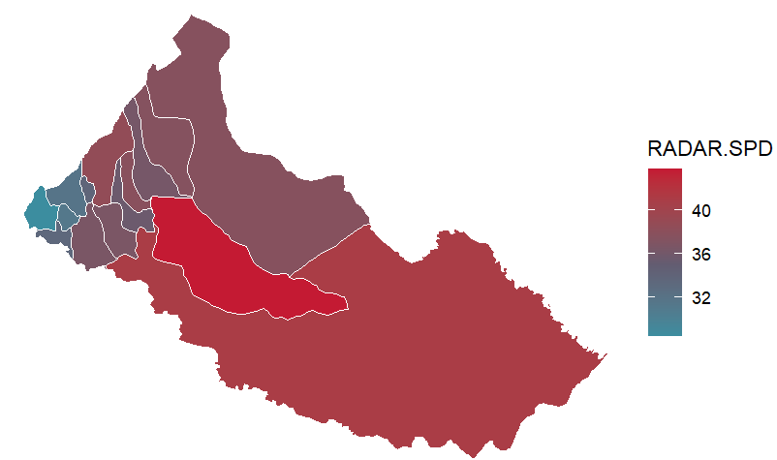
Caquetá – Radar de Servicios Públicos Domiciliarios
Top de municipios con el mayor valor en el Radar de Servicios Públicos
Subcomponentes del Radar
Subcomponentes de Corrupción
Subcomponentes de Servicios Públicos
Municipio | RADAR.SPD | 1 Corrupción | 2 Vulneración SPD | 1.1 Corrupción Observable | 1.2 Corrupción Oculta | 1.3 Capacidad Institucional | 2.1 Agua | 2.2 Energia | 2.3 Aseo
Cartagena del Chairá | 43.71 | 35.10 | 56.63 | 0.81 | 53.08 | 50.98 | 41.92 | 78.89 | 41.52
Solano | 40.94 | 32.77 | 53.20 | 1.35 | 49.93 | 50.98 | 56.07 | 43.54 | 66.79
Florencia | 38.57 | 37.24 | 40.56 | 10.52 | 51.50 | 50.98 | 46.84 | 27.54 | 54.06
Solita | 37.92 | 32.32 | 46.30 | 1.29 | 49.40 | 50.98 | 43.77 | 48.10 | 47.77
El Paujil | 37.82 | 31.14 | 47.84 | 1.52 | 47.82 | 50.98 | 40.57 | 50.08 | 57.88
San Vicente del Caguán | 37.58 | 36.18 | 39.67 | 3.88 | 53.08 | 50.98 | 54.61 | 16.61 | 55.93
Puerto Rico | 37.47 | 35.32 | 40.71 | 5.03 | 51.50 | 50.98 | 35.61 | 43.64 | 45.06
Milán | 36.66 | 33.26 | 41.78 | 5.16 | 48.87 | 50.98 | 34.97 | 46.62 | 45.71
Valparaíso | 36.59 | 31.51 | 44.20 | 1.37 | 48.35 | 50.98 | 56.35 | 25.88 | 56.54
El Doncello | 36.28 | 32.00 | 42.69 | 1.58 | 48.87 | 50.98 | 46.08 | 37.15 | 47.01

Slide 11
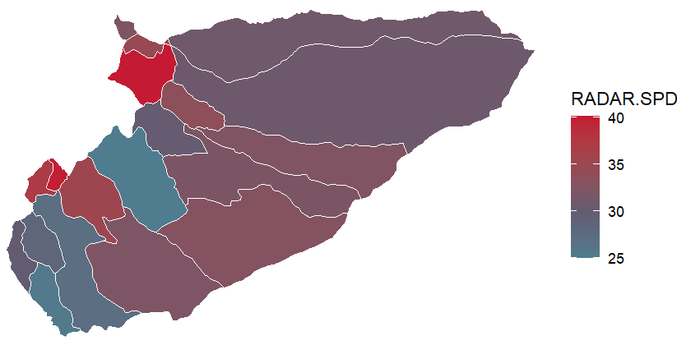
Casanare – Radar de Servicios Públicos Domiciliarios
Top de municipios con el mayor valor en el Radar de Servicios Públicos Domiciliarios
Subcomponentes del Radar
Subcomponentes de Corrupción
Subcomponentes de Servicios Públicos
Municipio | RADAR.SPD | 1 Corrupción | 2 Vulneración SPD | 1.1 Corrupción Observable | 1.2 Corrupción Oculta | 1.3 Capacidad Institucional | 2.1 Agua | 2.2 Energia | 2.3 Aseo
Támara | 40.16 | 27.62 | 58.96 | 7.29 | 38.77 | 39.64 | 63.02 | 49.62 | 69.52
Recetor | 39.92 | 24.78 | 62.63 | 0.37 | 38.25 | 39.64 | 72.30 | 44.34 | 79.91
Chámeza | 37.16 | 27.99 | 50.90 | 8.34 | 38.77 | 39.64 | 53.01 | 46.03 | 56.42
Aguazul | 35.35 | 29.77 | 43.72 | 2.60 | 43.51 | 39.64 | 53.92 | 25.71 | 59.35
Sácama | 34.77 | 28.27 | 44.51 | 7.94 | 39.30 | 39.64 | 48.39 | 38.30 | 49.18
Pore | 33.67 | 25.90 | 45.34 | 3.56 | 38.25 | 39.64 | 56.25 | 26.07 | 62.05
Orocué | 32.81 | 26.81 | 41.80 | 6.16 | 38.25 | 39.64 | 44.03 | 36.77 | 47.40
Trinidad | 32.42 | 25.64 | 42.59 | 1.61 | 38.77 | 39.64 | 47.84 | 32.37 | 52.52
La Salina | 32.34 | 25.62 | 42.43 | 0.37 | 39.30 | 39.64 | 34.29 | 45.53 | 52.50
Maní | 32.15 | 25.54 | 42.05 | 1.34 | 38.77 | 39.64 | 54.44 | 24.31 | 52.75

Slide 12
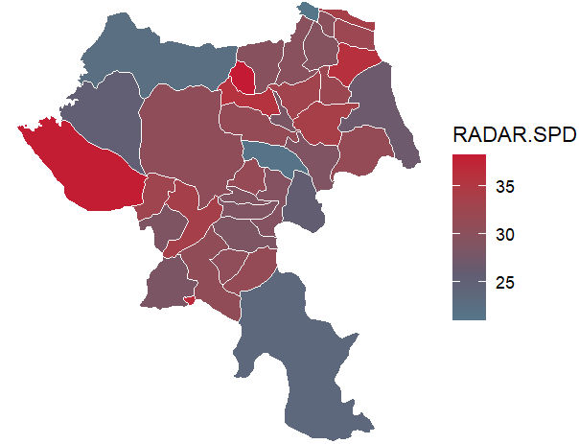
Cauca – Radar de Servicios Públicos Domiciliarios
Top de municipios con el mayor valor en el Radar de Servicios Públicos Domiciliarios
Subcomponentes del Radar
Subcomponentes de Corrupción
Subcomponentes de Servicios Públicos
Municipio | RADAR.SPD | 1 Corrupción | 2 Vulneración SPD | 1.1 Corrupción Observable | 1.2 Corrupción Oculta | 1.3 Capacidad Institucional | 2.1 Agua | 2.2 Energia | 2.3 Aseo
Suárez | 38.25 | 31.91 | 47.76 | 4.52 | 45.98 | 43.09 | 51.80 | 31.19 | 72.81
Guapi | 38.05 | 31.02 | 48.61 | 1.98 | 45.98 | 43.09 | 66.65 | 10.46 | 88.83
Florencia | 36.72 | 46.15 | 22.59 | 52.42 | 42.83 | 43.09 | 14.06 | 16.45 | 51.93
Toribío | 36.27 | 32.78 | 41.51 | 1.01 | 48.62 | 43.09 | 50.44 | 22.58 | 61.52
Morales | 35.89 | 35.45 | 36.54 | 6.22 | 49.67 | 43.09 | 34.09 | 30.88 | 52.77
Silvia | 33.91 | 27.76 | 43.13 | 1.09 | 42.30 | 43.09 | 55.01 | 15.27 | 75.09
Miranda | 33.85 | 33.68 | 34.09 | 3.58 | 48.62 | 43.09 | 47.32 | 13.02 | 49.78
Patía | 33.67 | 32.19 | 35.90 | 8.94 | 44.41 | 43.09 | 45.83 | 18.64 | 50.57
Caldono | 33.02 | 32.88 | 33.23 | 4.91 | 47.04 | 43.09 | 42.07 | 12.76 | 56.50
Argelia | 32.65 | 38.26 | 24.24 | 1.03 | 55.46 | 43.09 | 20.02 | 19.79 | 41.55

Slide 13
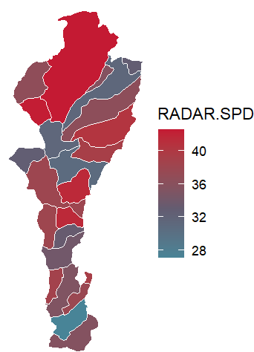
Cesar – Radar de Servicios Públicos Domiciliarios
Top de municipios con el mayor valor en el Radar de Servicios Públicos Domiciliarios
Subcomponentes del Radar
Subcomponentes de Corrupción
Subcomponentes de Servicios Públicos
Municipio | RADAR.SPD | 1 Corrupción | 2 Vulneración SPD | 1.1 Corrupción Observable | 1.2 Corrupción Oculta | 1.3 Capacidad Institucional | 2.1 Agua | 2.2 Energia | 2.3 Aseo
Pueblo Bello | 43.87 | 36.99 | 54.18 | 3.15 | 53.24 | 44.73 | 45.06 | 61.99 | 56.81
Valledupar | 42.59 | 44.78 | 39.30 | 17.00 | 56.93 | 44.73 | 24.31 | 64.63 | 18.64
Bosconia | 42.42 | 36.31 | 51.58 | 3.63 | 52.19 | 44.73 | 45.59 | 57.47 | 51.76
Curumaní | 41.64 | 36.10 | 49.95 | 3.03 | 52.19 | 44.73 | 49.92 | 49.21 | 51.49
Pailitas | 41.63 | 37.17 | 48.33 | 2.47 | 53.77 | 44.73 | 47.37 | 49.62 | 47.67
Becerril | 40.53 | 37.10 | 45.68 | 4.68 | 52.72 | 44.73 | 32.48 | 57.18 | 49.07
González | 39.26 | 35.76 | 44.51 | 0.85 | 52.72 | 44.73 | 40.27 | 48.60 | 44.80
La Jagua de Ibirico | 39.23 | 35.70 | 44.53 | 3.08 | 51.66 | 44.73 | 39.98 | 54.24 | 34.21
Gamarra | 38.73 | 38.44 | 39.16 | 9.72 | 52.19 | 44.73 | 42.75 | 42.09 | 26.12
Tamalameque | 38.18 | 36.66 | 40.44 | 3.43 | 52.72 | 44.73 | 26.90 | 63.43 | 21.56

Slide 14
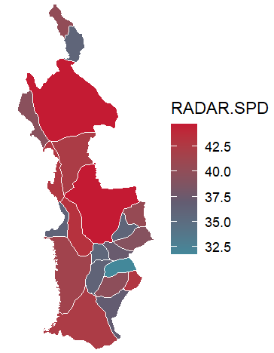
Chocó – Radar de Servicios Públicos Domiciliarios
Top de municipios con el mayor valor en el Radar de Servicios Públicos Domiciliarios
Subcomponentes del Radar
Subcomponentes de Corrupción
Subcomponentes de Servicios Públicos
Municipio | RADAR.SPD | 1 Corrupción | 2 Vulneración SPD | 1.1 Corrupción Observable | 1.2 Corrupción Oculta | 1.3 Capacidad Institucional | 2.1 Agua | 2.2 Energia | 2.3 Aseo
Carmen del Darién | 45.50 | 50.95 | 37.32 | 1.20 | 70.67 | 40.03 | 22.44 | 57.13 | 27.45
Quibdó | 44.72 | 57.70 | 25.25 | 13.25 | 73.83 | 40.03 | 41.56 | 7.78 | 27.57
Riosucio | 44.68 | 50.47 | 36.01 | 2.22 | 69.62 | 40.03 | 51.22 | 36.59 | 4.42
Alto Baudó | 43.31 | 53.98 | 27.29 | 1.44 | 74.36 | 40.03 | 22.75 | 31.06 | 28.86
Bahía Solano | 42.87 | 54.50 | 25.44 | 12.54 | 70.14 | 40.03 | 36.00 | 7.78 | 39.63
San José del Palmar | 42.85 | 48.04 | 35.08 | 3.69 | 65.93 | 40.03 | 32.17 | 37.36 | 36.34
El Litoral del San Juan | 42.38 | 54.97 | 23.50 | 1.84 | 75.41 | 40.03 | 19.49 | 28.70 | 21.15
Bojayá | 42.30 | 53.30 | 25.80 | 3.09 | 72.78 | 40.03 | 29.71 | 21.24 | 27.10
Medio Baudó | 41.78 | 48.63 | 31.49 | 1.80 | 67.51 | 40.03 | 39.11 | 25.77 | 27.68
Río Iró | 41.60 | 51.70 | 26.45 | 4.54 | 70.14 | 40.03 | 26.24 | 33.47 | 12.85

Slide 15
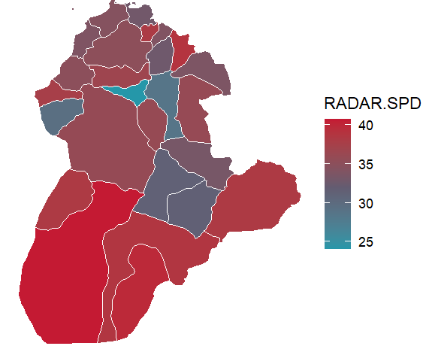
Córdoba – Radar de Servicios Públicos Domiciliarios
Top de municipios con el mayor valor en el Radar de Servicios Públicos Domiciliarios
Subcomponentes del Radar
Subcomponentes de Corrupción
Subcomponentes de Servicios Públicos
Municipio | RADAR.SPD | 1 Corrupción | 2 Vulneración SPD | 1.1 Corrupción Observable | 1.2 Corrupción Oculta | 1.3 Capacidad Institucional | 2.1 Agua | 2.2 Energia | 2.3 Aseo
Tierralta | 40.74 | 38.82 | 43.61 | 4.38 | 58.94 | 65.74 | 29.97 | 51.96 | 54.20
Puerto Libertador | 39.84 | 36.51 | 44.83 | 2.59 | 56.83 | 65.74 | 41.70 | 50.33 | 40.08
San Andrés Sotavento | 38.95 | 31.95 | 49.47 | 3.98 | 50.52 | 65.74 | 50.58 | 47.71 | 50.75
Montelíbano | 38.69 | 36.28 | 42.31 | 3.12 | 56.31 | 65.74 | 41.01 | 41.36 | 46.79
San José de Ure | 38.67 | 35.27 | 43.76 | 1.46 | 55.78 | 65.74 | 43.42 | 47.93 | 36.08
Ayapel | 38.28 | 32.17 | 47.45 | 1.02 | 52.10 | 65.74 | 51.29 | 49.37 | 35.91
Valencia | 38.28 | 31.57 | 48.34 | 1.71 | 51.05 | 65.74 | 45.83 | 52.84 | 44.34
Purísima | 38.19 | 33.12 | 45.80 | 8.52 | 49.99 | 65.74 | 55.29 | 36.23 | 45.95
La Apartada | 37.83 | 33.20 | 44.77 | 2.76 | 52.62 | 65.74 | 33.69 | 57.85 | 40.79
Los Córdobas | 37.61 | 31.98 | 46.07 | 2.86 | 51.05 | 65.74 | 44.73 | 48.06 | 44.78

Slide 16
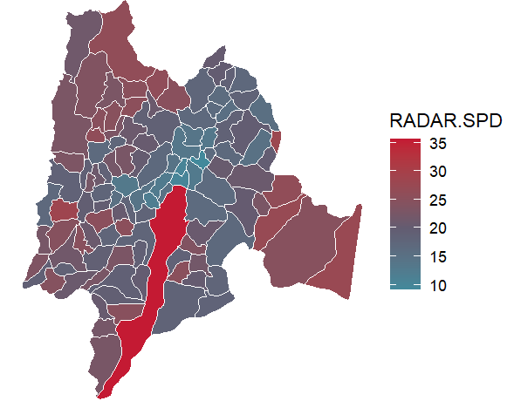
Cundinamarca – Radar de Servicios Públicos Domiciliarios
Top de municipios con el mayor valor en el Radar de Servicios Públicos Domiciliarios
Subcomponentes del Radar
Subcomponentes de Corrupción
Subcomponentes de Servicios Públicos
Municipio | RADAR.SPD | 1 Corrupción | 2 Vulneración SPD | 1.1 Corrupción Observable | 1.2 Corrupción Oculta | 1.3 Capacidad Institucional | 2.1 Agua | 2.2 Energia | 2.3 Aseo
Pulí | 28.46 | 11.69 | 53.63 | 0.12 | 27.00 | 66.38 | 63.88 | 36.05 | 68.27
Tibirita | 27.87 | 12.97 | 50.22 | 3.78 | 27.00 | 66.38 | 58.96 | 27.93 | 77.33
Paratebueno | 27.56 | 14.22 | 47.56 | 6.16 | 27.53 | 66.38 | 69.53 | 16.85 | 65.06
Gachalá | 27.20 | 13.56 | 47.68 | 5.46 | 27.00 | 66.38 | 49.97 | 41.60 | 55.26
Ubalá | 26.32 | 15.22 | 42.96 | 10.22 | 27.00 | 66.38 | 47.76 | 33.23 | 52.81
Yacopí | 26.20 | 14.87 | 43.20 | 8.02 | 27.53 | 66.38 | 47.13 | 35.88 | 49.98
Paime | 26.06 | 13.83 | 44.42 | 6.24 | 27.00 | 66.38 | 48.34 | 36.88 | 51.65
Quebradanegra | 26.05 | 12.86 | 45.84 | 3.46 | 27.00 | 66.38 | 56.85 | 23.35 | 68.78
El Peñón | 25.44 | 12.43 | 44.96 | 2.25 | 27.00 | 66.38 | 50.78 | 33.69 | 55.87
San Antonio del Tequendama | 25.39 | 15.20 | 40.68 | 10.16 | 27.00 | 66.38 | 52.42 | 22.00 | 54.55

Slide 17
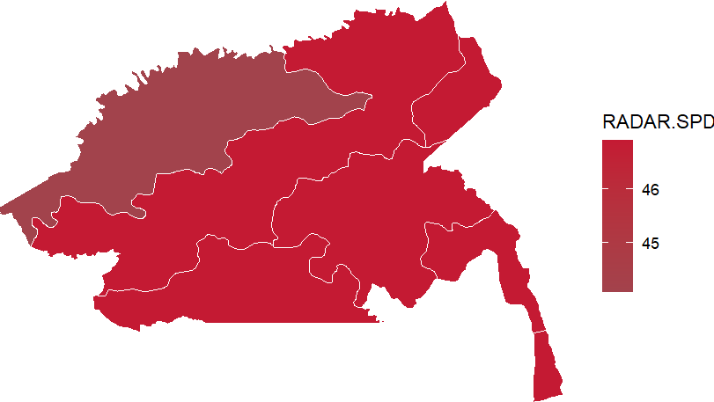
Guainía – Radar de Servicios Públicos Domiciliarios
Radar de Servicios Públicos Domiciliarios por municipios
Subcomponentes del Radar
Subcomponentes de Corrupción
Subcomponentes de Servicios Públicos
Municipio | RADAR.SPD | 1 Corrupción | 2 Vulneración SPD | 1.1 Corrupción Observable | 1.2 Corrupción Oculta | 1.3 Capacidad Institucional | 2.1 Agua | 2.2 Energia | 2.3 Aseo
Inírida | 49.72 | 50.41 | 48.69 | 13.00 | 73.68 | 87.19 | 73.00 | 13.89 | 69.67
Barrancominas | 44.09 | 44.51 | 43.45 | 4.57 | 69.99 | 87.19 | 41.82 | 44.20 | 45.21

Slide 18
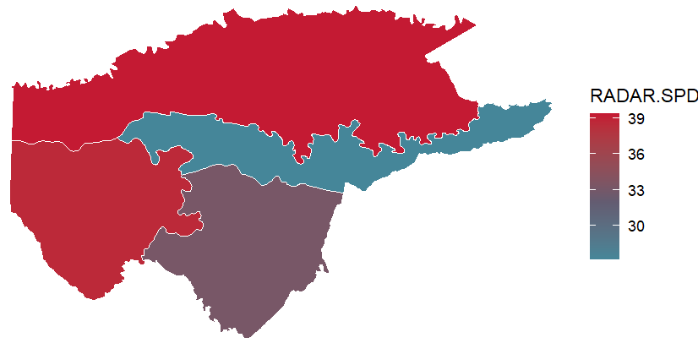
Guaviare – Radar de Servicios Públicos Domiciliarios
Top de municipios con el mayor valor en el Radar de Servicios Públicos Domiciliarios
Subcomponentes del Radar
Subcomponentes de Corrupción
Subcomponentes de Servicios Públicos
Municipio | RADAR.SPD | 1 Corrupción | 2 Vulneración SPD | 1.1 Corrupción Observable | 1.2 Corrupción Oculta | 1.3 Capacidad Institucional | 2.1 Agua | 2.2 Energia | 2.3 Aseo
San José del Guaviare | 39.36 | 34.99 | 45.91 | 7.70 | 56.30 | 84.96 | 68.53 | 8.74 | 75.01
Calamar | 38.63 | 30.41 | 50.95 | 6.64 | 51.04 | 84.96 | 56.79 | 46.42 | 48.35
Miraflores | 33.20 | 30.12 | 37.82 | 7.02 | 50.51 | 84.96 | 45.67 | 29.59 | 38.56
El Retorno | 27.20 | 32.12 | 19.82 | 5.49 | 53.67 | 84.96 | 19.07 | 16.10 | 28.78

Slide 19
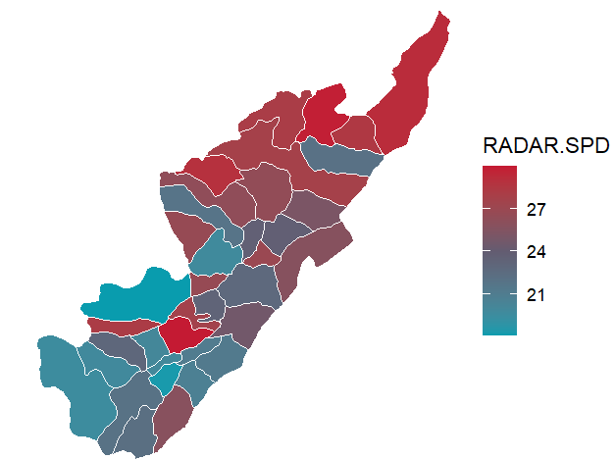
Huila – Radar de Servicios Públicos Domiciliarios
Top de municipios con el mayor valor en el Radar de Servicios Públicos Domiciliarios
Subcomponentes del Radar
Subcomponentes de Corrupción
Subcomponentes de Servicios Públicos
Municipio | RADAR.SPD | 1 Corrupción | 2 Vulneración SPD | 1.1 Corrupción Observable | 1.2 Corrupción Oculta | 1.3 Capacidad Institucional | 2.1 Agua | 2.2 Energia | 2.3 Aseo
Tarqui | 29.98 | 22.38 | 41.39 | 2.10 | 39.70 | 67.42 | 52.78 | 11.82 | 77.75
Villavieja | 29.81 | 28.15 | 32.31 | 19.78 | 39.17 | 67.42 | 45.22 | 6.34 | 58.45
Colombia | 29.20 | 26.26 | 33.61 | 11.98 | 40.22 | 67.42 | 43.45 | 14.99 | 51.18
Santa María | 28.90 | 24.70 | 35.20 | 7.54 | 40.22 | 67.42 | 47.91 | 14.57 | 51.04
Baraya | 28.42 | 26.52 | 31.27 | 4.31 | 43.91 | 67.42 | 32.32 | 22.80 | 46.09
La Argentina | 28.12 | 23.76 | 34.67 | 6.03 | 39.70 | 67.42 | 47.08 | 13.99 | 51.20
Aipe | 28.07 | 23.85 | 34.41 | 6.30 | 39.70 | 67.42 | 53.86 | 3.86 | 56.60
Neiva | 27.71 | 29.61 | 24.86 | 10.74 | 44.96 | 67.42 | 37.90 | 3.86 | 40.76
Pital | 27.54 | 24.23 | 32.52 | 7.39 | 39.70 | 67.42 | 49.94 | 5.41 | 51.88
Hobo | 26.99 | 23.50 | 32.22 | 5.30 | 39.70 | 67.42 | 43.51 | 7.68 | 58.70

Slide 20
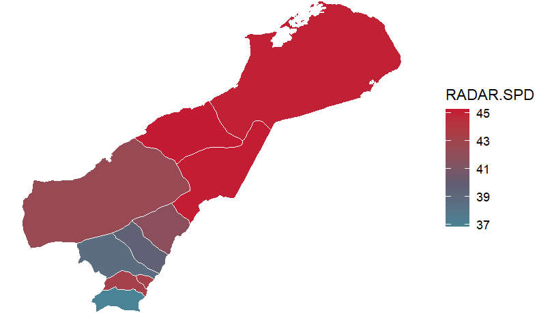
La Guajira – Radar de Servicios Públicos Domiciliarios
Top de municipios con el mayor valor en el Radar de Servicios Públicos
Subcomponentes del Radar
Subcomponentes de Corrupción
Subcomponentes de Servicios Públicos
Municipio | RADAR.SPD | 1 Corrupción | 2 Vulneración SPD | 1.1 Corrupción Observable | 1.2 Corrupción Oculta | 1.3 Capacidad Institucional | 2.1 Agua | 2.2 Energia | 2.3 Aseo
La Jagua del Pilar | 45.73 | 53.39 | 34.23 | 34.62 | 66.59 | 79.97 | 28.03 | 38.66 | 37.78
Manaure | 45.28 | 41.92 | 50.31 | 1.84 | 66.59 | 79.97 | 39.20 | 69.75 | 33.67
Maicao | 45.20 | 44.68 | 45.98 | 4.92 | 68.69 | 79.97 | 31.67 | 56.22 | 54.13
Uribia | 45.07 | 45.17 | 44.94 | 1.49 | 70.80 | 79.97 | 19.42 | 71.96 | 41.94
Villanueva | 43.27 | 42.56 | 44.35 | 2.46 | 67.11 | 79.97 | 39.06 | 54.62 | 34.35
El Molino | 43.25 | 44.09 | 42.00 | 5.63 | 67.64 | 79.97 | 37.29 | 47.30 | 40.85
Riohacha | 42.46 | 49.42 | 32.02 | 11.24 | 71.85 | 79.97 | 32.83 | 33.19 | 28.07
Hatonuevo | 41.84 | 43.42 | 39.47 | 6.13 | 66.59 | 79.97 | 35.58 | 48.20 | 29.77
Barrancas | 41.81 | 44.89 | 37.20 | 4.30 | 69.22 | 79.97 | 34.83 | 42.39 | 31.56
Dibulla | 41.01 | 44.71 | 35.45 | 1.40 | 70.27 | 79.97 | 36.09 | 34.04 | 36.98

Slide 21
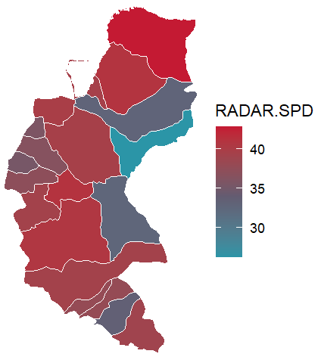
Magdalena – Radar de Servicios Públicos Domiciliarios
Top de municipios con el mayor valor en el Radar de Servicios Públicos Domiciliarios
Subcomponentes del Radar
Subcomponentes de Corrupción
Subcomponentes de Servicios Públicos
Municipio | RADAR.SPD | 1 Corrupción | 2 Vulneración SPD | 1.1 Corrupción Observable | 1.2 Corrupción Oculta | 1.3 Capacidad Institucional | 2.1 Agua | 2.2 Energia | 2.3 Aseo
Santa Marta | 42.82 | 42.67 | 43.04 | 20.00 | 59.86 | 81.41 | 56.69 | 32.52 | 36.78
Chibolo | 41.04 | 33.94 | 51.68 | 2.26 | 56.70 | 81.41 | 56.57 | 52.10 | 41.09
Ciénaga | 40.95 | 37.68 | 45.85 | 4.54 | 60.38 | 81.41 | 50.20 | 36.08 | 56.71
Plato | 40.66 | 34.44 | 50.00 | 3.70 | 56.70 | 81.41 | 47.81 | 54.03 | 46.31
Santa Bárbara de Pinto | 40.04 | 33.99 | 49.11 | 2.41 | 56.70 | 81.41 | 37.98 | 66.19 | 37.21
Remolino | 39.87 | 33.93 | 48.79 | 2.24 | 56.70 | 81.41 | 38.33 | 65.10 | 37.08
Pivijay | 39.58 | 34.25 | 47.57 | 3.16 | 56.70 | 81.41 | 54.80 | 33.96 | 60.31
Puebloviejo | 39.55 | 34.08 | 47.76 | 2.66 | 56.70 | 81.41 | 28.73 | 81.08 | 19.21
Santa Ana | 39.32 | 34.31 | 46.84 | 3.34 | 56.70 | 81.41 | 42.91 | 53.58 | 41.24
Tenerife | 39.30 | 34.98 | 45.78 | 5.24 | 56.70 | 81.41 | 42.75 | 56.14 | 31.10

Slide 22
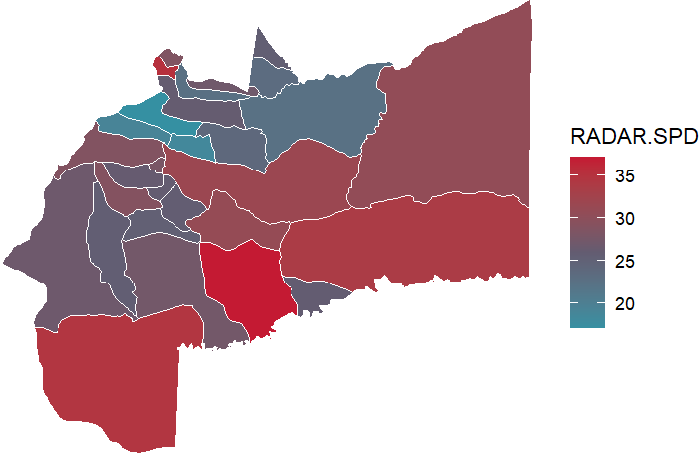
Meta – Radar de Servicios Públicos Domiciliarios
Top de municipios con el mayor valor en el Radar de Servicios Públicos Domiciliarios
Subcomponentes del Radar
Subcomponentes de Corrupción
Subcomponentes de Servicios Públicos
Municipio | RADAR.SPD | 1 Corrupción | 2 Vulneración SPD | 1.1 Corrupción Observable | 1.2 Corrupción Oculta | 1.3 Capacidad Institucional | 2.1 Agua | 2.2 Energia | 2.3 Aseo
Puerto Rico | 37.13 | 23.61 | 57.41 | 2.02 | 38.65 | 53.49 | 66.96 | 40.03 | 73.09
El Calvario | 35.23 | 22.14 | 54.87 | 12.26 | 32.34 | 53.49 | 60.29 | 44.05 | 65.68
La Macarena | 34.58 | 24.77 | 49.29 | 1.72 | 40.23 | 53.49 | 44.37 | 54.35 | 49.02
Mapiripán | 33.72 | 22.84 | 50.04 | 9.44 | 34.44 | 53.49 | 50.27 | 48.61 | 52.46
San Martín | 31.65 | 20.48 | 48.40 | 2.72 | 34.44 | 53.49 | 55.78 | 34.90 | 60.67
Puerto Lleras | 30.95 | 21.89 | 44.54 | 3.12 | 36.02 | 53.49 | 46.60 | 39.82 | 49.86
Puerto Gaitán | 30.54 | 25.61 | 37.93 | 11.35 | 37.07 | 53.49 | 47.16 | 16.65 | 62.03
Lejanías | 29.04 | 22.89 | 38.26 | 1.17 | 38.13 | 53.49 | 57.53 | 8.23 | 59.76
Cubarral | 28.86 | 24.10 | 35.99 | 8.25 | 36.55 | 53.49 | 44.75 | 21.00 | 48.45
San Juanito | 28.60 | 23.51 | 36.23 | 16.17 | 32.34 | 53.49 | 42.36 | 35.40 | 25.63

Slide 23
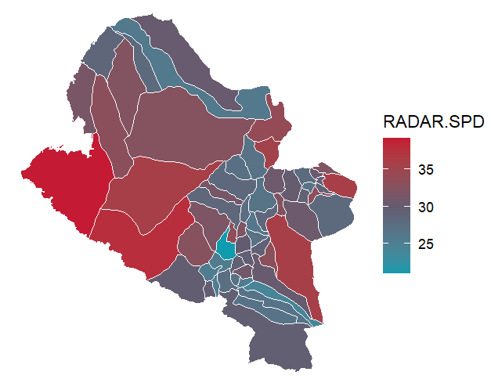
Nariño – Radar de Servicios Públicos Domiciliarios
Top de municipios con el mayor valor en el Radar de Servicios Públicos
Subcomponentes del Radar
Subcomponentes de Corrupción
Subcomponentes de Servicios Públicos
Municipio | RADAR.SPD | 1 Corrupción | 2 Vulneración SPD | 1.1 Corrupción Observable | 1.2 Corrupción Oculta | 1.3 Capacidad Institucional | 2.1 Agua | 2.2 Energia | 2.3 Aseo
San Andrés de Tumaco | 39.14 | 38.30 | 40.40 | 7.38 | 53.89 | 49.34 | 47.78 | 36.31 | 33.80
Ricaurte | 37.77 | 33.36 | 44.40 | 8.90 | 47.05 | 49.34 | 51.81 | 32.96 | 52.45
La Cruz | 35.95 | 27.56 | 48.54 | 4.37 | 41.79 | 49.34 | 67.90 | 18.48 | 69.95
Barbacoas | 35.92 | 34.68 | 37.78 | 1.85 | 51.79 | 49.34 | 35.68 | 38.48 | 40.57
Pasto | 35.89 | 32.82 | 40.50 | 15.80 | 43.37 | 49.34 | 58.12 | 10.08 | 66.08
El Rosario | 35.38 | 28.98 | 44.98 | 6.03 | 42.84 | 49.34 | 46.79 | 39.64 | 52.03
Nariño | 34.76 | 42.68 | 22.87 | 46.38 | 42.31 | 49.34 | 29.26 | 10.08 | 35.69
Leiva | 33.94 | 30.87 | 38.55 | 4.22 | 46.00 | 49.34 | 44.92 | 28.18 | 46.55
Providencia | 33.45 | 31.34 | 36.61 | 13.98 | 42.31 | 49.34 | 49.11 | 21.83 | 41.18
Albán | 33.19 | 30.25 | 37.60 | 10.86 | 42.31 | 49.34 | 40.74 | 29.75 | 47.05

Slide 24
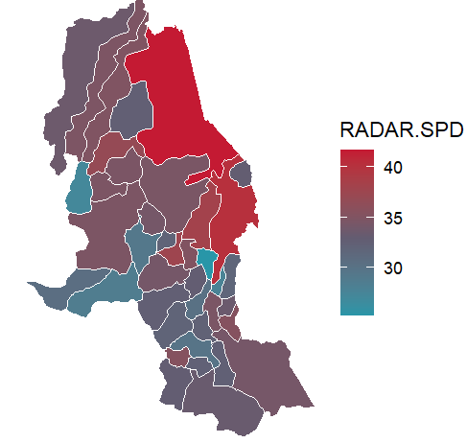
Norte de Santander – Radar de Servicios Públicos Domiciliarios
Top de municipios con el mayor valor en el Radar de Servicios Públicos
Subcomponentes del Radar
Subcomponentes de Corrupción
Subcomponentes de Servicios Públicos
Municipio | RADAR.SPD | 1 Corrupción | 2 Vulneración SPD | 1.1 Corrupción Observable | 1.2 Corrupción Oculta | 1.3 Capacidad Institucional | 2.1 Agua | 2.2 Energia | 2.3 Aseo
Tibú | 41.64 | 42.43 | 40.44 | 3.69 | 60.25 | 47.07 | 62.58 | 4.28 | 68.50
Cúcuta | 40.23 | 46.34 | 31.07 | 14.86 | 60.25 | 47.07 | 52.59 | 4.28 | 41.62
El Zulia | 38.16 | 42.92 | 31.01 | 13.52 | 56.57 | 47.07 | 47.41 | 4.28 | 51.69
Gramalote | 37.68 | 32.08 | 46.09 | 6.59 | 46.04 | 47.07 | 66.15 | 14.35 | 69.43
San Calixto | 36.87 | 36.45 | 37.51 | 2.23 | 53.41 | 47.07 | 46.85 | 22.38 | 49.11
Mutiscua | 35.48 | 33.53 | 38.42 | 10.73 | 46.04 | 47.07 | 50.48 | 16.49 | 58.15
Herrán | 35.42 | 30.43 | 42.90 | 0.68 | 46.57 | 47.07 | 45.66 | 36.40 | 50.39
Santiago | 35.14 | 31.34 | 40.84 | 4.48 | 46.04 | 47.07 | 44.75 | 33.01 | 48.69
Teorama | 35.06 | 38.40 | 30.04 | 2.99 | 55.52 | 47.07 | 46.64 | 4.28 | 48.40
Convención | 34.77 | 35.97 | 32.97 | 2.06 | 52.88 | 47.07 | 48.89 | 4.28 | 58.48

Slide 25
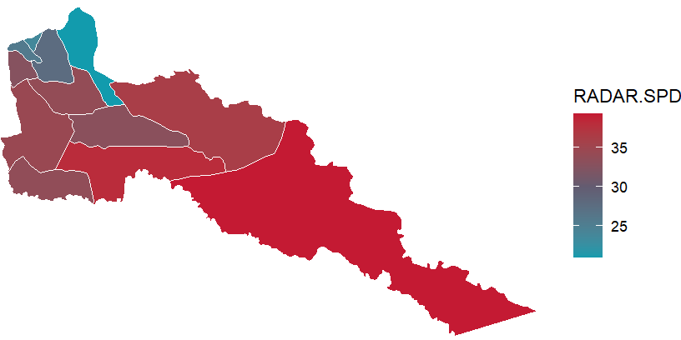
Putumayo – Radar de Servicios Públicos Domiciliarios
Radar de Servicios Públicos Domiciliarios por municipios
Subcomponentes del Radar
Subcomponentes de Corrupción
Subcomponentes de Servicios Públicos
Municipio | RADAR.SPD | 1 Corrupción | 2 Vulneración SPD | 1.1 Corrupción Observable | 1.2 Corrupción Oculta | 1.3 Capacidad Institucional | 2.1 Agua | 2.2 Energia | 2.3 Aseo
Puerto Leguízamo | 39.28 | 29.23 | 54.36 | 3.35 | 43.67 | 45.85 | 70.24 | 30.08 | 71.19
Puerto Asís | 38.08 | 31.05 | 48.64 | 3.74 | 45.77 | 45.85 | 56.76 | 38.18 | 53.30
Puerto Guzmán | 36.16 | 28.19 | 48.12 | 1.58 | 43.14 | 45.85 | 50.18 | 44.43 | 51.39
San Miguel | 34.80 | 26.05 | 47.92 | 2.68 | 39.98 | 45.85 | 68.58 | 24.71 | 53.04
Orito | 34.56 | 30.61 | 40.47 | 2.49 | 45.77 | 45.85 | 46.53 | 29.66 | 49.99
Villagarzón | 33.94 | 29.95 | 39.93 | 5.42 | 43.67 | 45.85 | 58.95 | 8.98 | 63.79
Valle del Guamuez | 33.72 | 28.58 | 41.42 | 1.50 | 43.67 | 45.85 | 46.18 | 32.57 | 49.58
Puerto Caicedo | 33.04 | 28.08 | 40.48 | 1.27 | 43.14 | 45.85 | 45.37 | 34.70 | 42.25
Santiago | 32.70 | 24.45 | 45.09 | 7.74 | 35.77 | 45.85 | 58.33 | 26.73 | 55.32
San Francisco | 27.71 | 22.25 | 35.90 | 0.25 | 36.30 | 45.85 | 47.12 | 21.63 | 42.00
Colón | 25.71 | 23.36 | 29.22 | 3.43 | 36.30 | 45.85 | 26.12 | 21.38 | 51.11
Sibundoy | 23.75 | 23.89 | 23.54 | 2.53 | 37.35 | 45.85 | 18.60 | 17.89 | 44.73
Mocoa | 20.98 | 27.72 | 10.87 | 7.46 | 39.98 | 45.85 | 10.79 | 11.44 | 9.88

Slide 26
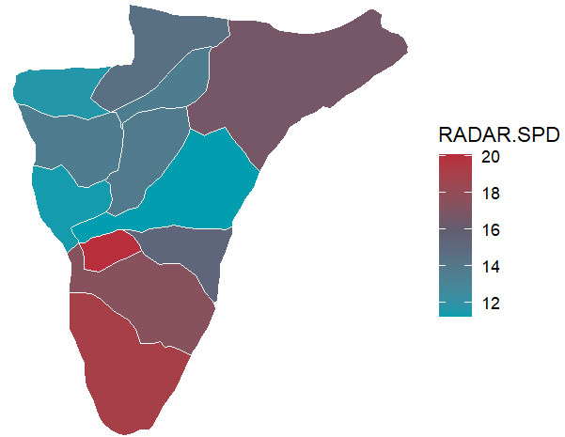
Quindío – Radar de Servicios Públicos Domiciliarios
Radar de Servicios Públicos Domiciliarios por municipios
Subcomponentes del Radar
Subcomponentes de Corrupción
Subcomponentes de Servicios Públicos
Municipio | RADAR.SPD | 1 Corrupción | 2 Vulneración SPD | 1.1 Corrupción Observable | 1.2 Corrupción Oculta | 1.3 Capacidad Institucional | 2.1 Agua | 2.2 Energia | 2.3 Aseo
Buenavista | 20.05 | 9.61 | 35.71 | 0.07 | 23.52 | 61.49 | 41.72 | 24.57 | 45.99
Génova | 19.06 | 10.20 | 32.36 | 1.73 | 23.52 | 61.49 | 33.51 | 17.12 | 60.54
Pijao | 17.43 | 11.47 | 26.37 | 5.38 | 23.52 | 61.49 | 26.32 | 19.58 | 40.04
Salento | 16.71 | 11.53 | 24.49 | 5.54 | 23.52 | 61.49 | 24.57 | 15.87 | 41.58
Córdoba | 15.25 | 11.20 | 21.32 | 4.60 | 23.52 | 61.49 | 15.75 | 11.70 | 51.70
Filandia | 14.52 | 10.62 | 20.37 | 2.93 | 23.52 | 61.49 | 15.11 | 11.13 | 49.37
Armenia | 13.81 | 14.69 | 12.48 | 8.55 | 26.15 | 61.49 | 22.08 | 1.18 | 15.90
Montenegro | 13.59 | 9.96 | 19.04 | 1.06 | 23.52 | 61.49 | 20.90 | 6.69 | 40.04
Circasia | 13.57 | 10.48 | 18.20 | 1.33 | 24.04 | 61.49 | 24.66 | 6.39 | 28.91
Quimbaya | 11.68 | 10.83 | 12.94 | 3.55 | 23.52 | 61.49 | 14.24 | 2.69 | 30.87
La Tebaida | 11.42 | 10.88 | 12.23 | 3.68 | 23.52 | 61.49 | 11.25 | 14.57 | 9.51
Calarcá | 11.27 | 11.44 | 11.01 | 5.29 | 23.52 | 61.49 | 2.52 | 24.42 | 1.16

Slide 27
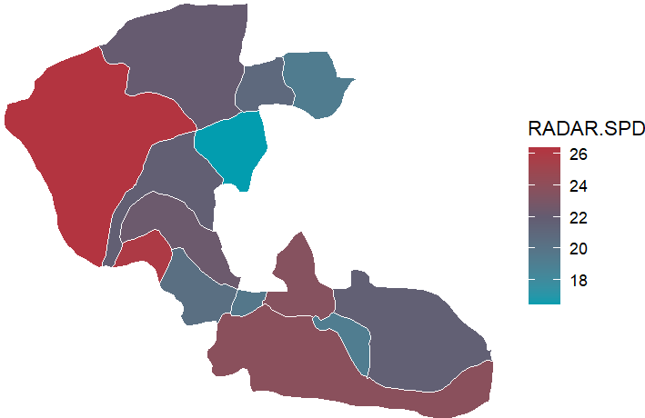
Risaralda – Radar de Servicios Públicos Domiciliarios
Radar de Servicios Públicos Domiciliarios por municipios
Subcomponentes del Radar
Subcomponentes de Corrupción
Subcomponentes de Servicios Públicos
Municipio | RADAR.SPD | 1 Corrupción | 2 Vulneración SPD | 1.1 Corrupción Observable | 1.2 Corrupción Oculta | 1.3 Capacidad Institucional | 2.1 Agua | 2.2 Energia | 2.3 Aseo
Pueblo Rico | 26.36 | 21.28 | 33.97 | 2.79 | 33.96 | 45.75 | 35.95 | 20.84 | 56.29
La Celia | 25.93 | 19.19 | 36.05 | 6.43 | 29.75 | 45.75 | 48.24 | 14.67 | 54.43
Pereira | 23.84 | 23.37 | 24.53 | 11.17 | 32.91 | 45.75 | 37.83 | 4.92 | 37.15
Marsella | 23.61 | 17.30 | 33.07 | 2.24 | 29.23 | 45.75 | 43.84 | 14.55 | 48.57
Santuario | 22.37 | 17.47 | 29.73 | 1.51 | 29.75 | 45.75 | 37.45 | 16.16 | 41.44
Mistrató | 22.11 | 18.18 | 27.99 | 1.15 | 30.80 | 45.75 | 26.66 | 19.15 | 48.35
Apía | 21.78 | 18.43 | 26.81 | 4.27 | 29.75 | 45.75 | 30.85 | 19.79 | 32.77
Santa Rosa de Cabal | 21.70 | 18.67 | 26.25 | 4.96 | 29.75 | 45.75 | 38.12 | 2.63 | 49.74
Guática | 20.91 | 18.26 | 24.90 | 4.97 | 29.23 | 45.75 | 30.20 | 6.47 | 51.17
Balboa | 20.41 | 17.25 | 25.15 | 2.10 | 29.23 | 45.75 | 37.13 | 3.20 | 45.12
La Virginia | 19.68 | 17.66 | 22.71 | 3.26 | 29.23 | 45.75 | 32.89 | 6.43 | 34.93
Quinchía | 19.28 | 17.05 | 22.63 | 1.53 | 29.23 | 45.75 | 24.72 | 3.54 | 56.64
Dosquebradas | 19.21 | 20.51 | 17.26 | 2.99 | 32.91 | 45.75 | 28.36 | 2.63 | 24.35
Belén de Umbría | 16.48 | 17.91 | 14.34 | 2.79 | 29.75 | 45.75 | 11.98 | 10.66 | 26.41

Slide 28
San Andrés y Providencia – Radar de Servicios Públicos Domiciliarios
Radar de Servicios Públicos Domiciliarios por municipios
Subcomponentes del Radar
Subcomponentes de Corrupción
Subcomponentes de Servicios Públicos
Municipio | RADAR.SPD | 1 Corrupción | 2 Vulneración SPD | 1.1 Corrupción Observable | 1.2 Corrupción Oculta | 1.3 Capacidad Institucional | 2.1 Agua | 2.2 Energia | 2.3 Aseo
San Andrés y Providencia | 14.63 | 7.55 | 25.25 | 6.74 | 17.21 | 57.17 | 31.83 | 12.91 | 36.75

Slide 29
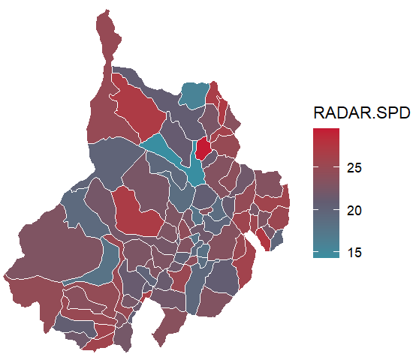
Santander – Radar de Servicios Públicos Domiciliarios
Top de municipios con el mayor valor en el Radar de Servicios Públicos Domiciliarios
Subcomponentes del Radar
Subcomponentes de Corrupción
Subcomponentes de Servicios Públicos
Municipio | RADAR.SPD | 1 Corrupción | 2 Vulneración SPD | 1.1 Corrupción Observable | 1.2 Corrupción Oculta | 1.3 Capacidad Institucional | 2.1 Agua | 2.2 Energia | 2.3 Aseo
Bucaramanga | 29.60 | 27.13 | 33.30 | 17.81 | 35.72 | 51.13 | 50.92 | 2.70 | 59.27
Capitanejo | 27.61 | 18.79 | 40.84 | 5.99 | 30.45 | 51.13 | 54.74 | 13.65 | 67.41
California | 27.23 | 24.23 | 31.73 | 22.74 | 29.93 | 51.13 | 40.61 | 16.62 | 44.19
Sabana de Torres | 27.12 | 19.78 | 38.12 | 5.21 | 32.03 | 51.13 | 59.49 | 4.50 | 62.62
El Carmen de Chucurí | 26.90 | 17.19 | 41.46 | 2.64 | 29.93 | 51.13 | 50.21 | 22.16 | 62.56
Suratá | 26.71 | 21.32 | 34.79 | 14.44 | 29.93 | 51.13 | 44.14 | 11.65 | 62.37
San Benito | 26.45 | 17.50 | 39.88 | 3.50 | 29.93 | 51.13 | 54.32 | 12.67 | 65.44
Charta | 26.14 | 20.55 | 34.52 | 12.23 | 29.93 | 51.13 | 37.63 | 21.11 | 55.14
Onzaga | 26.01 | 19.12 | 36.36 | 4.53 | 31.50 | 51.13 | 42.10 | 22.58 | 52.41
Albania | 25.89 | 19.39 | 35.63 | 8.92 | 29.93 | 51.13 | 47.61 | 16.81 | 49.32

Slide 30
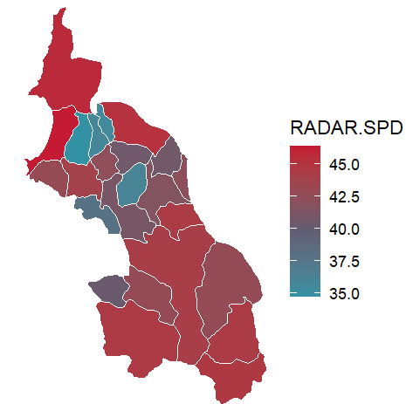
Sucre – Radar de Servicios Públicos Domiciliarios
Top de municipios con el mayor valor en el Radar de Servicios Públicos Domiciliarios
Subcomponentes del Radar
Subcomponentes de Corrupción
Subcomponentes de Servicios Públicos
Municipio | RADAR.SPD | 1 Corrupción | 2 Vulneración SPD | 1.1 Corrupción Observable | 1.2 Corrupción Oculta | 1.3 Capacidad Institucional | 2.1 Agua | 2.2 Energia | 2.3 Aseo
Santiago de Tolú | 46.34 | 43.89 | 50.02 | 4.01 | 60.39 | 38.87 | 35.14 | 61.67 | 56.49
San Onofre | 45.63 | 46.60 | 44.18 | 3.33 | 64.08 | 38.87 | 43.66 | 44.79 | 44.00
Ovejas | 45.19 | 46.30 | 43.52 | 2.48 | 64.08 | 38.87 | 47.61 | 39.63 | 43.11
Guaranda | 44.65 | 46.48 | 41.92 | 3.00 | 64.08 | 38.87 | 47.14 | 32.85 | 49.61
San Marcos | 44.43 | 46.07 | 41.97 | 4.22 | 63.02 | 38.87 | 49.60 | 27.77 | 55.09
Galeras | 44.41 | 45.78 | 42.37 | 7.00 | 61.44 | 38.87 | 48.52 | 29.08 | 56.62
Majagual | 44.40 | 47.80 | 39.31 | 6.76 | 64.08 | 38.87 | 39.01 | 32.71 | 53.13
San Benito Abad | 44.18 | 44.35 | 43.92 | 1.73 | 61.97 | 38.87 | 38.55 | 45.74 | 51.03
San Luis de Sincé | 43.82 | 45.46 | 41.36 | 4.90 | 61.97 | 38.87 | 36.83 | 43.86 | 45.41
Sincelejo | 43.80 | 48.77 | 36.35 | 10.75 | 63.55 | 38.87 | 28.87 | 35.53 | 52.96

Slide 31
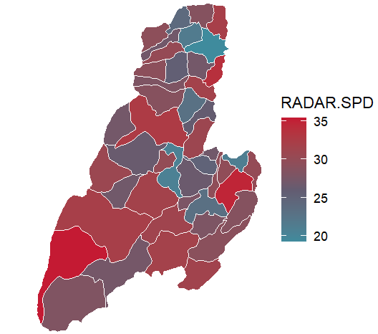
Tolima – Radar de Servicios Públicos Domiciliarios
Top de municipios con el mayor valor en el Radar de Servicios Públicos Domiciliarios
Subcomponentes del Radar
Subcomponentes de Corrupción
Subcomponentes de Servicios Públicos
Municipio | RADAR.SPD | 1 Corrupción | 2 Vulneración SPD | 1.1 Corrupción Observable | 1.2 Corrupción Oculta | 1.3 Capacidad Institucional | 2.1 Agua | 2.2 Energia | 2.3 Aseo
Rioblanco | 35.38 | 25.70 | 49.90 | 4.10 | 38.44 | 43.24 | 69.06 | 18.27 | 74.84
Cunday | 34.74 | 28.53 | 44.05 | 17.00 | 36.34 | 43.24 | 56.48 | 17.71 | 71.86
Ambalema | 33.82 | 26.02 | 45.51 | 5.01 | 38.44 | 43.24 | 46.44 | 38.20 | 58.29
Ibagué | 32.65 | 31.84 | 33.87 | 18.01 | 40.02 | 43.24 | 48.66 | 8.78 | 54.49
Chaparral | 32.08 | 26.87 | 39.91 | 6.23 | 38.97 | 43.24 | 44.52 | 25.33 | 59.83
Honda | 32.05 | 29.81 | 35.42 | 15.82 | 38.44 | 43.24 | 43.36 | 19.23 | 51.92
Natagaima | 31.69 | 24.64 | 42.28 | 4.66 | 36.86 | 43.24 | 53.76 | 19.73 | 64.41
Venadillo | 31.64 | 30.36 | 33.56 | 22.21 | 36.34 | 43.24 | 45.58 | 11.95 | 52.75
Ortega | 31.63 | 25.15 | 41.36 | 3.72 | 37.92 | 43.24 | 47.73 | 24.18 | 62.98
Alpujarra | 31.44 | 25.65 | 40.12 | 7.57 | 36.86 | 43.24 | 44.60 | 26.96 | 57.48

Slide 32
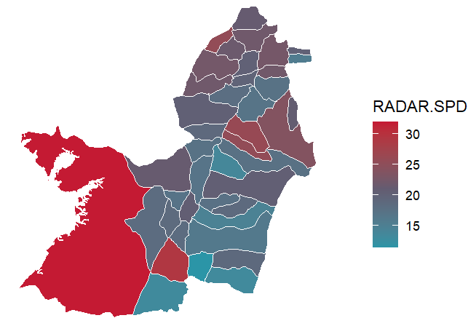
Valle del Cauca – Radar de Servicios Públicos Domiciliarios
Top de municipios con el mayor valor en el Radar de Servicios Públicos Domiciliarios
Subcomponentes del Radar
Subcomponentes de Corrupción
Subcomponentes de Servicios Públicos
Municipio | RADAR.SPD | 1 Corrupción | 2 Vulneración SPD | 1.1 Corrupción Observable | 1.2 Corrupción Oculta | 1.3 Capacidad Institucional | 2.1 Agua | 2.2 Energia | 2.3 Aseo
Buenaventura | 31.89 | 29.42 | 35.58 | 10.07 | 45.23 | 68.57 | 44.83 | 20.57 | 47.13
Cali | 29.24 | 28.05 | 31.01 | 27.82 | 35.75 | 68.57 | 43.84 | 8.64 | 50.08
Bugalagrande | 26.08 | 19.52 | 35.93 | 15.47 | 30.49 | 68.57 | 53.76 | 7.70 | 56.70
El Cairo | 25.55 | 16.93 | 38.49 | 9.27 | 29.96 | 68.57 | 43.59 | 27.44 | 50.39
Andalucía | 25.50 | 16.05 | 39.67 | 5.55 | 30.49 | 68.57 | 52.29 | 16.11 | 61.54
Sevilla | 23.91 | 16.82 | 34.53 | 6.56 | 31.02 | 68.57 | 46.96 | 12.42 | 53.91
Cartago | 22.53 | 16.18 | 32.06 | 7.14 | 29.96 | 68.57 | 50.02 | 3.45 | 53.35
Versalles | 22.45 | 16.28 | 31.71 | 8.62 | 29.44 | 68.57 | 37.29 | 19.38 | 45.20
Obando | 22.15 | 14.46 | 33.69 | 3.41 | 29.44 | 68.57 | 34.44 | 25.16 | 49.25
El Dovio | 22.08 | 17.45 | 29.03 | 9.55 | 30.49 | 68.57 | 35.49 | 14.20 | 45.77

Slide 33
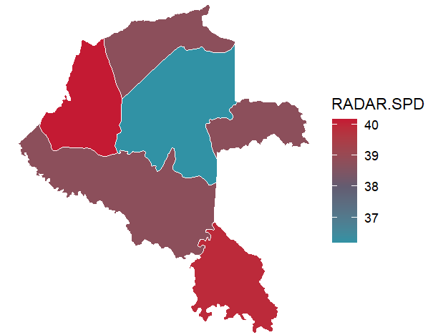
Vaupés – Radar de Servicios Públicos Domiciliarios
Radar de Servicios Públicos Domiciliarios por municipios
Subcomponentes del Radar
Subcomponentes de Corrupción
Subcomponentes de Servicios Públicos
Municipio | RADAR.SPD | 1 Corrupción | 2 Vulneración SPD | 1.1 Corrupción Observable | 1.2 Corrupción Oculta | 1.3 Capacidad Institucional | 2.1 Agua | 2.2 Energia | 2.3 Aseo
Carurú | 40.16 | 41.95 | 37.49 | 5.44 | 60.44 | 55.39 | 39.92 | 34.25 | 39.13
Taraira | 39.93 | 41.31 | 37.87 | 0.00 | 62.02 | 55.39 | 41.00 | 32.99 | 41.38
Mitú | 36.19 | 41.62 | 28.04 | 4.50 | 60.44 | 55.39 | 41.14 | 9.17 | 39.61

Slide 34
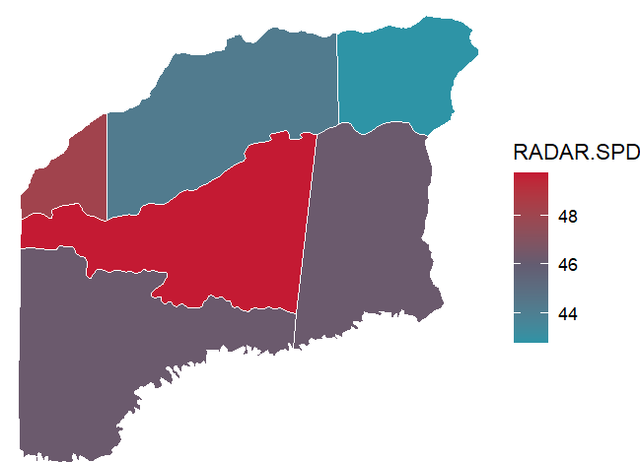
Vichada – Radar de Servicios Públicos Domiciliarios
Top de municipios con el mayor valor en el Radar de Servicios Públicos
Subcomponentes del Radar
Subcomponentes de Corrupción
Subcomponentes de Servicios Públicos
Municipio | RADAR.SPD | 1 Corrupción | 2 Vulneración SPD | 1.1 Corrupción Observable | 1.2 Corrupción Oculta | 1.3 Capacidad Institucional | 2.1 Agua | 2.2 Energia | 2.3 Aseo
Cumaribo | 49.76 | 47.81 | 52.68 | 0.87 | 70.31 | 58.28 | 51.08 | 55.43 | 50.38
Santa Rosalía | 48.17 | 47.19 | 49.65 | 1.51 | 69.26 | 58.28 | 45.86 | 54.04 | 48.44
La Primavera | 44.19 | 52.37 | 31.91 | 5.48 | 73.99 | 58.28 | 44.62 | 10.90 | 48.51
Puerto Carreño | 42.78 | 52.04 | 28.88 | 11.76 | 70.84 | 58.28 | 37.64 | 17.62 | 33.91

Slide 35
Gracias!

